Slide 1
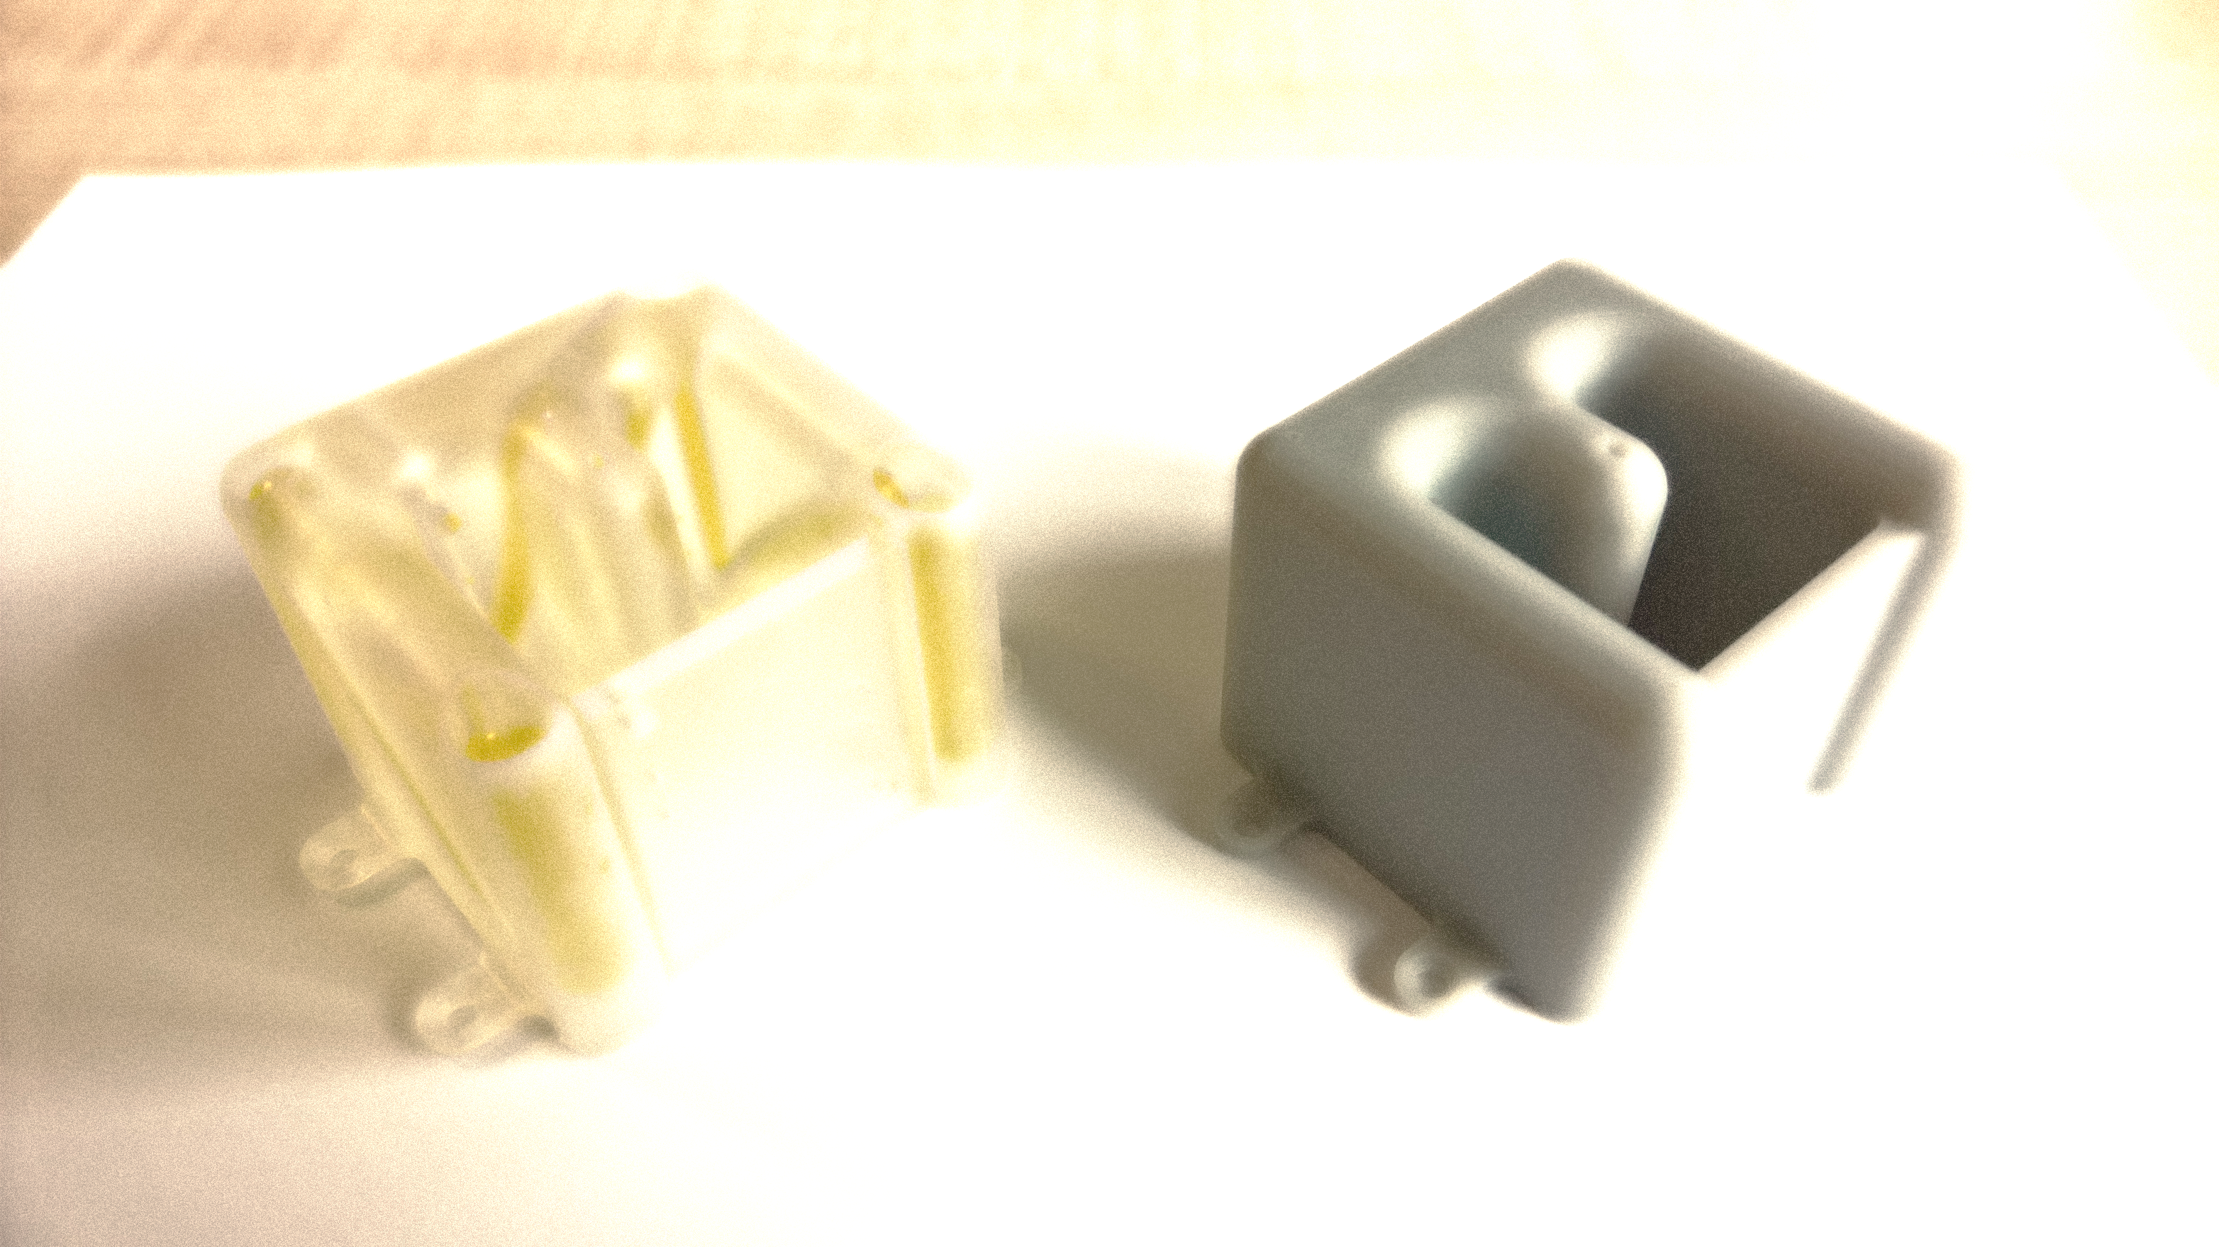
Characterization and automated alignment detection of an additively manufactured Z-frame marker to process signals for robotic control in interventional MRI
Parisa Parsanejad
Parisa.parsanejad@yahoo.com
Medical Systems Engineering
Supervisors: Prof. Dr. Michael Friebe
M. Sc. Robert Odenbach
07.06. 2018

Slide 2
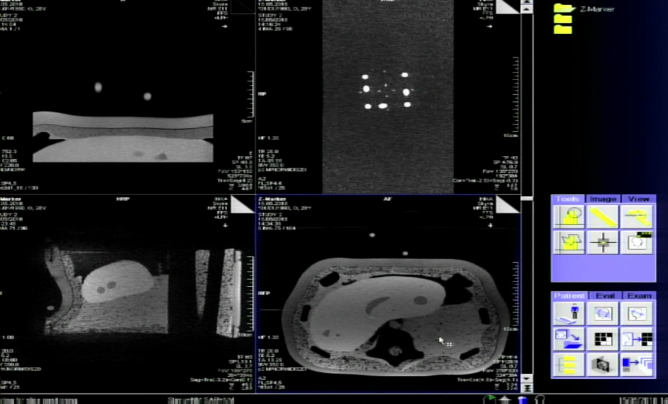

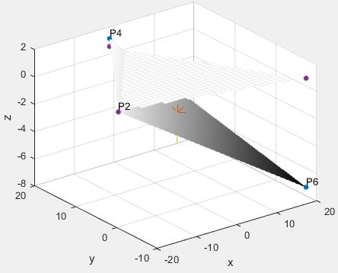
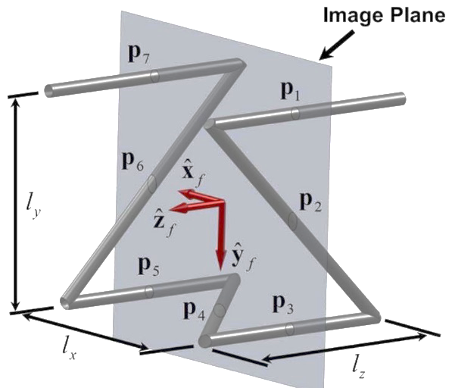
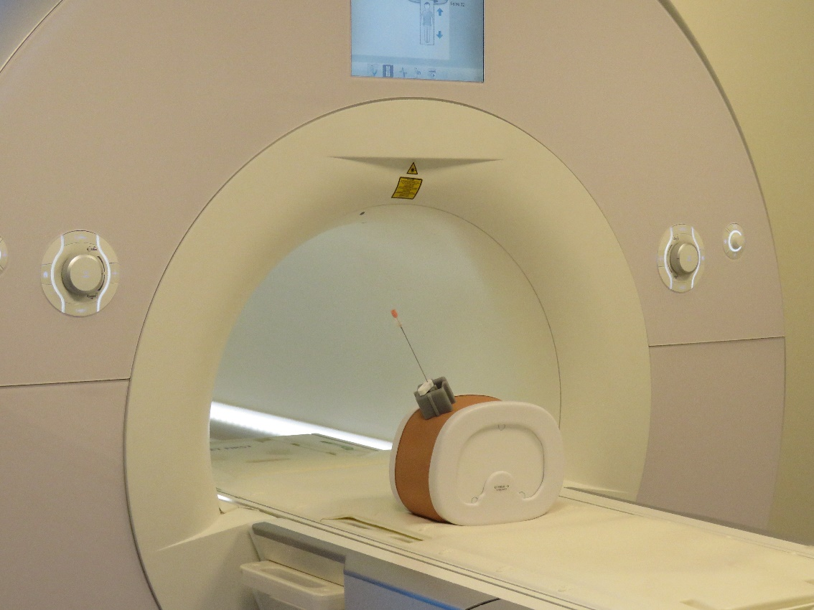
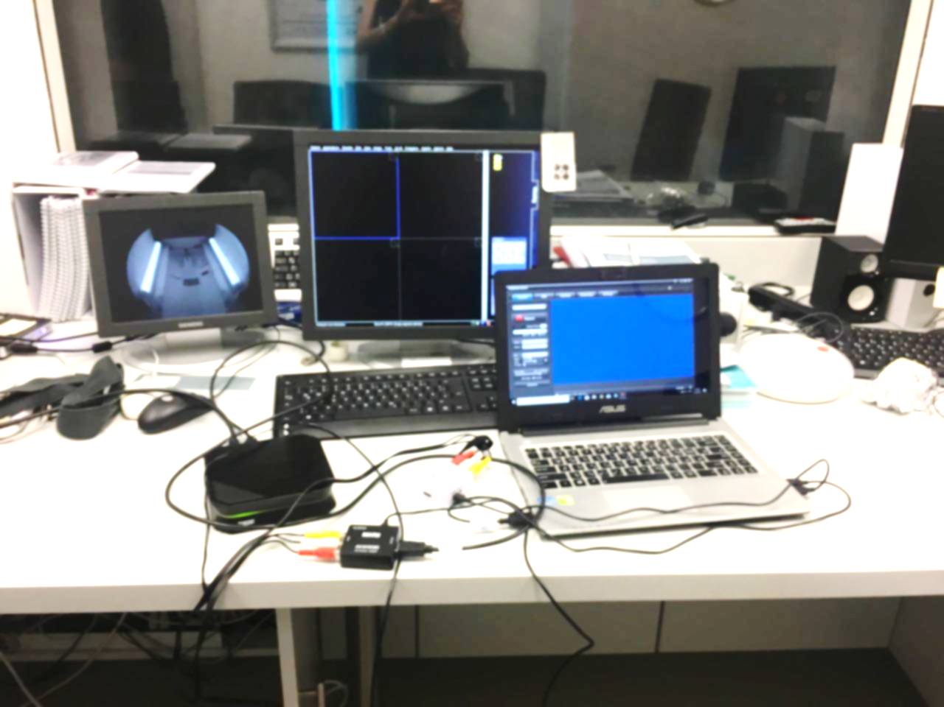
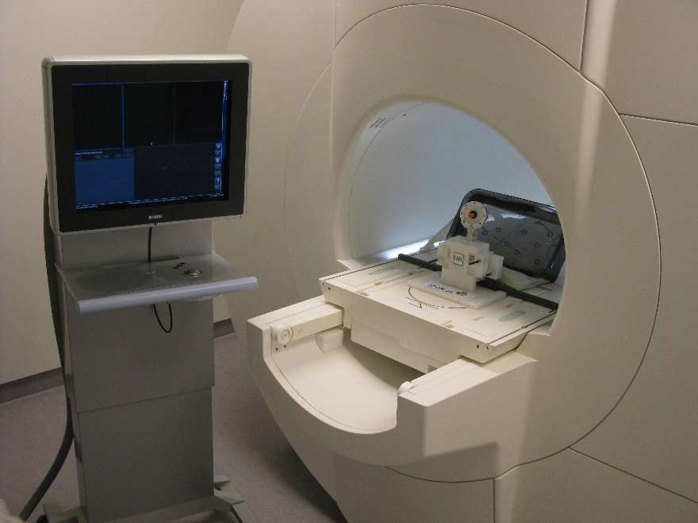
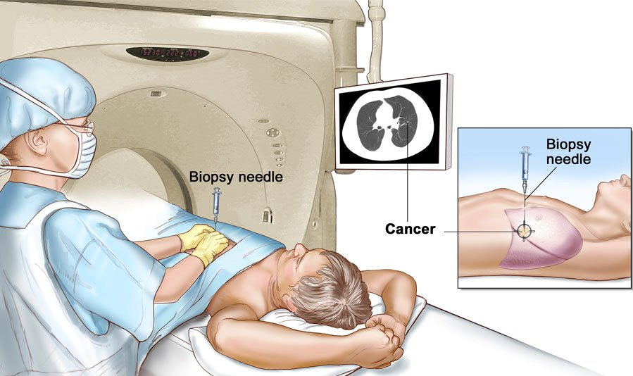
Contents
Introduction
Processing methods
Results
Conclusion and outlook
GUI live demonstration

Slide 3
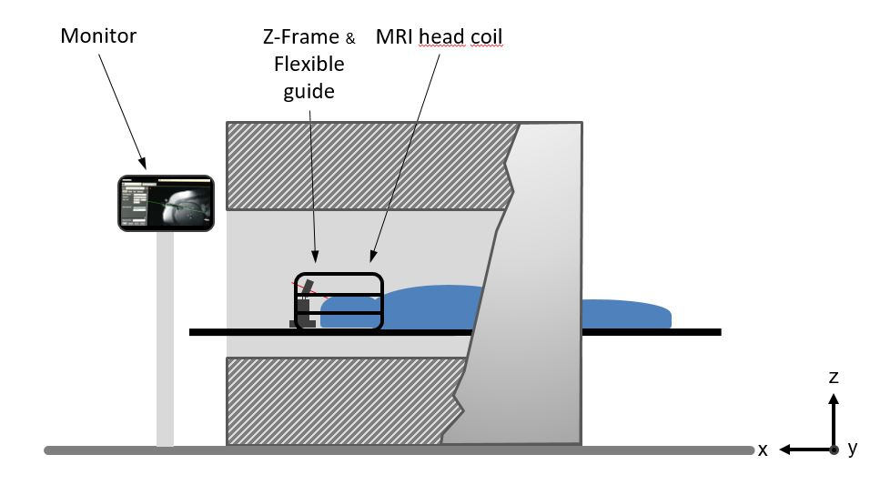
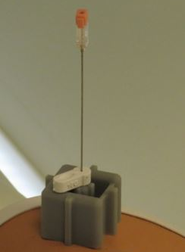
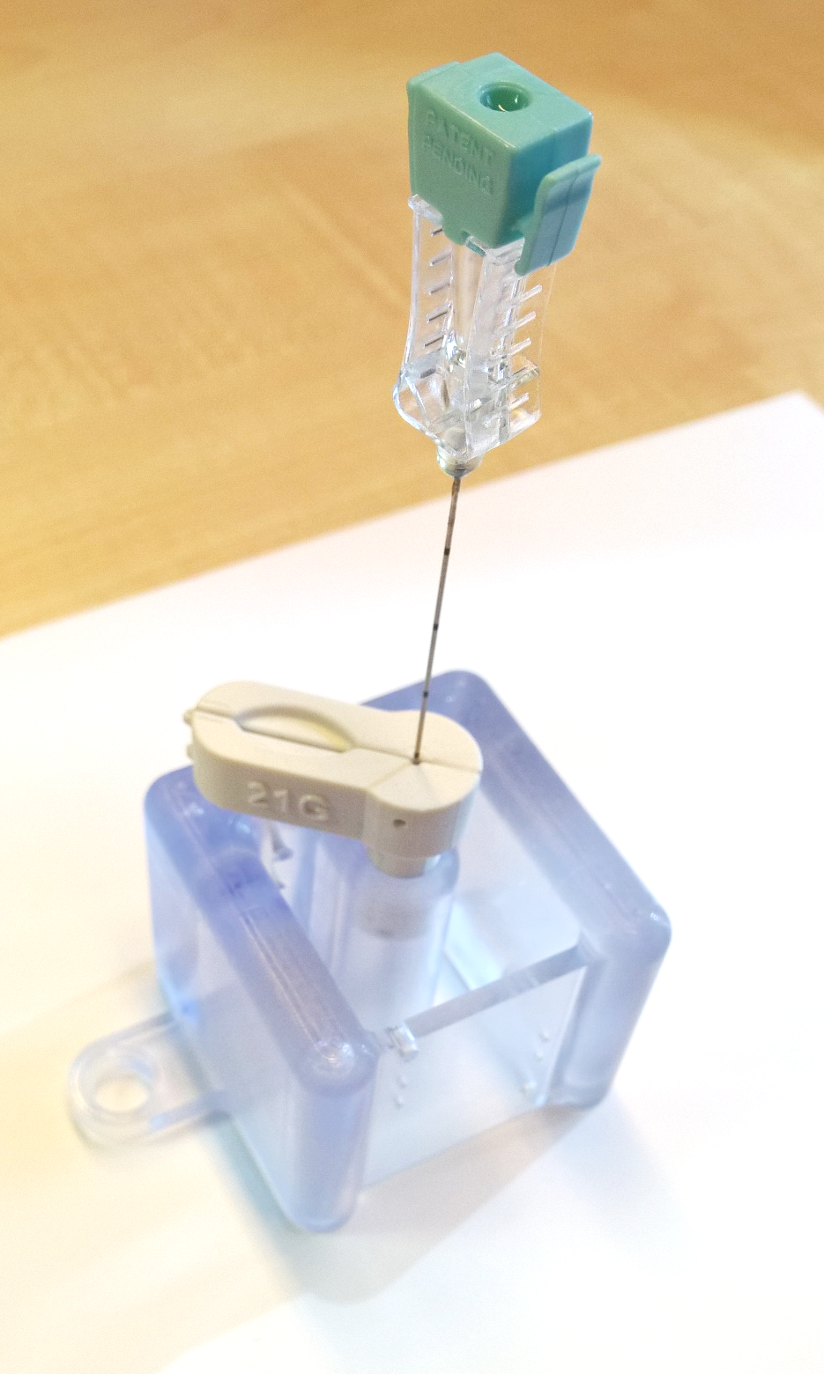
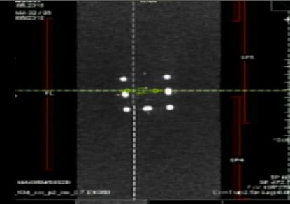
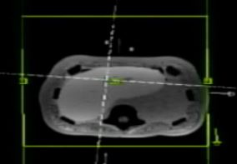
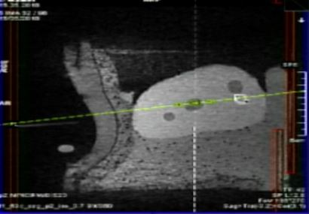
3D-printed Z-frame marker
Needle alignment to the image plane
A full six degree-of-freedom estimate of a device’s pose in
MRI coordinates using a single image slice of the frame
Notes:
Z-frame is a passive tracking marker
control and tracking of the position and orientation of the instrument
designed with internal cylindrical tunnels, which are aligned in vertical and 45°-orientation at three sides (= Z-shape).
A single image slice will show seven ellipses, the centroids are used for localizing the frame
The benefit from the Z-shaped marker design is that the full 6-DOF (DOF = degree of freedom) pose of the device can be extracted from the relationship of the dots that show up on the image.
Our new marker concept uses the same design with the Z-shaped tunnels, but it is fully additively manufactured.

Slide 4
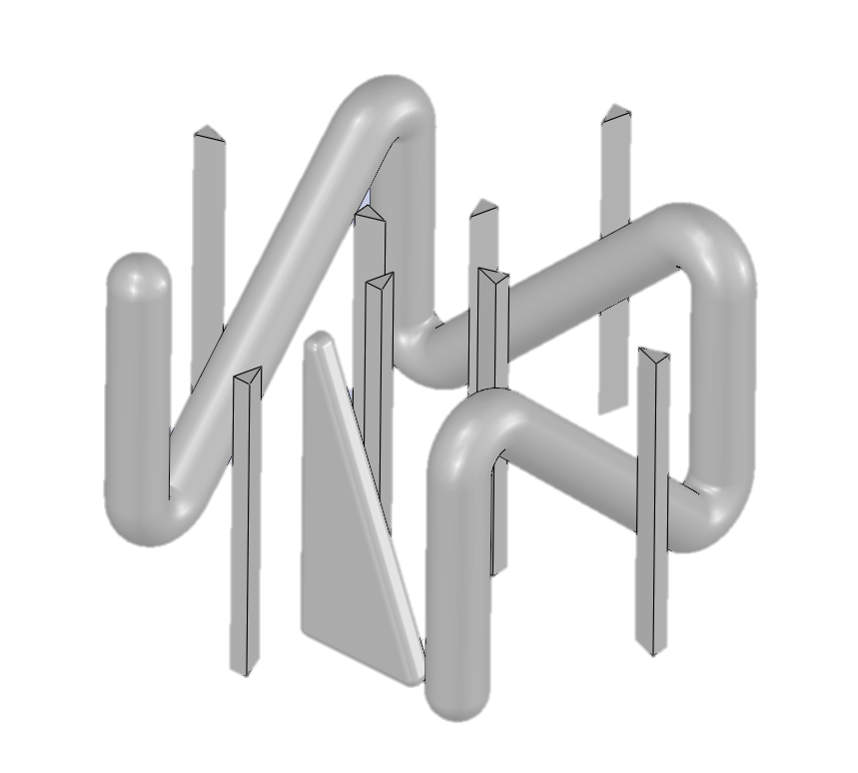
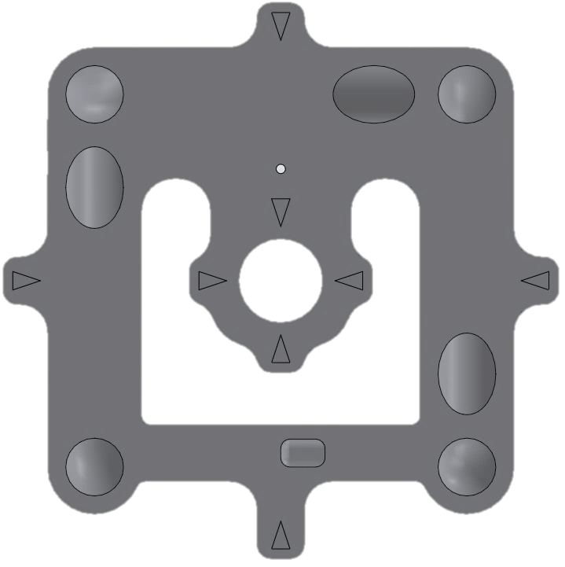
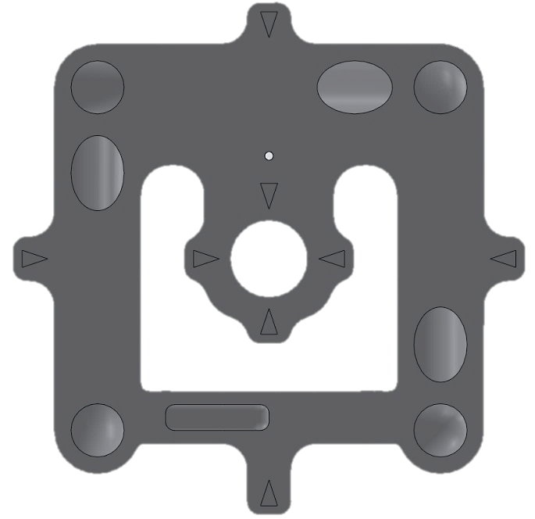
3D-printed Z-frame marker
Internal Z-shaped tunnel structure without any entrance from the outside
New features:
View correction triangle
Center pointing triangles
P5
P4
P3
P3
P4
P5
P6
P2
P2
P6
P7
P1
P1
P7
Fig .1: Z-RP-MR-marker with the distinct shaped internal tunnels in the CAD-view
Fig .2: Top view of the marker
Z= +10 mm
Fig .3: Bottom view of the marker
Z= -10 mm
Notes:
Clear identification of the correct view of the marker
Z-frame is a passive tracking marker
control and tracking of the position and orientation of the instrument
designed with internal cylindrical tunnels, which are aligned in vertical and 45°-orientation at three sides (= Z-shape).
A single image slice will show seven ellipses, the centroids are used for localizing the frame
The benefit from the Z-shaped marker design is that the full 6-DOF (DOF = degree of freedom) pose of the device can be extracted from the relationship of the dots that show up on the image.
Our new marker concept uses the same design with the Z-shaped tunnels, but it is fully additively manufactured.

Slide 5
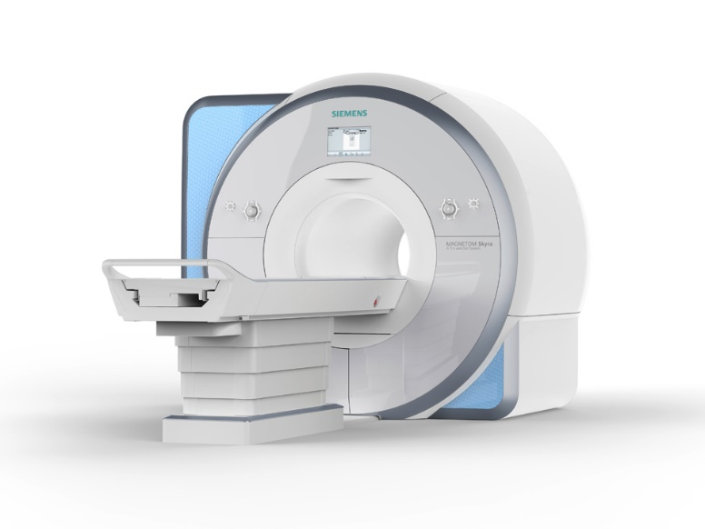
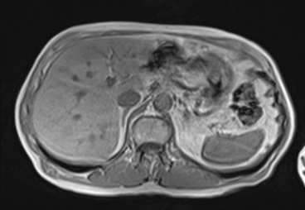
Configuration of robot-assisted iMRI
Robotic
Device with
Attached
Z-frame Marker
Scanner Room
MRI Scanner
Robot Controller
MRI Hardware
Control Room
Status
Command
Navigation
Workstation
MRI Host Workstation

Slide 6
Navigation workstation: Real-time localization algorithm
Image pre-processing
stage
Localization and registration stage
Image filtering
and
segmentation
Marker alignment calculation
Validity test and calibration
Rigid transformation matrix
Center detection of the fiducials ellipses
Robot movement
to the goal position
Real time MR imaging
Angle calculation of image plane & frame
Distance measurements between centroids
Instrument trajectory estimation
Validity test and calibration
Robotic device motion calculation

Slide 7
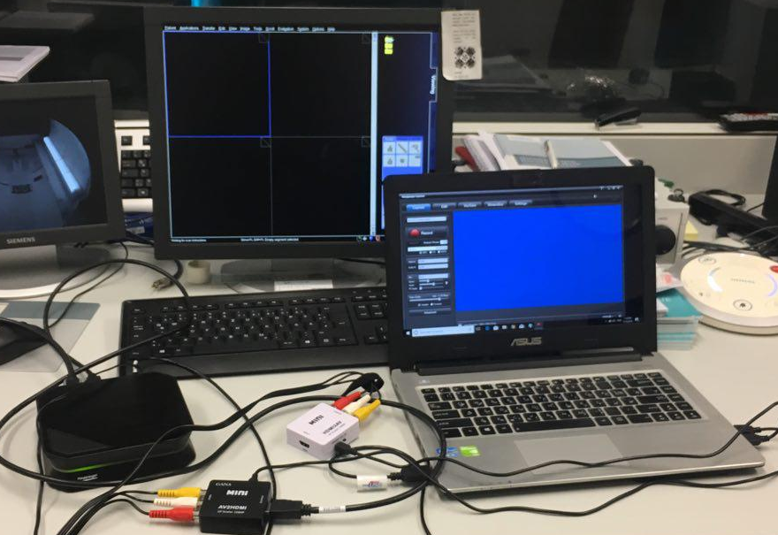
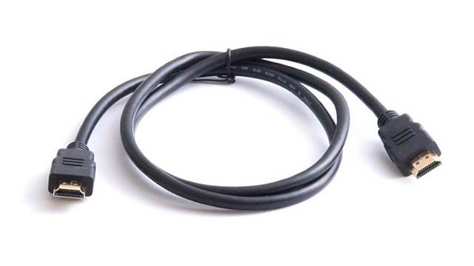
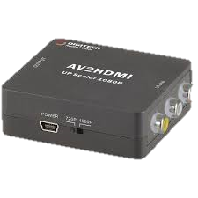
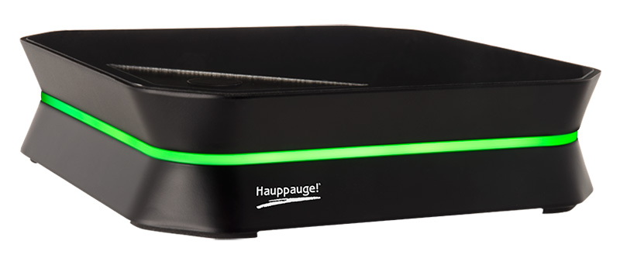
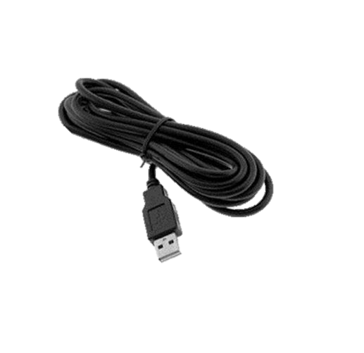
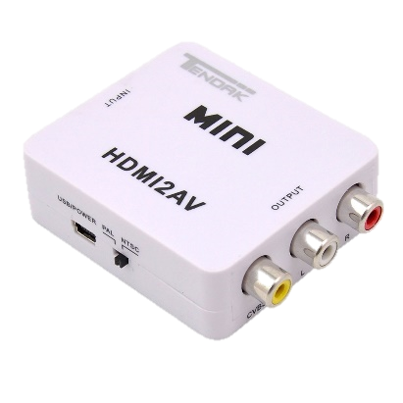
Hardware setup for real-time image capturing
MRI setup with
capture device
HD- video recorder
HDMI and USB cables
Converter

Slide 8
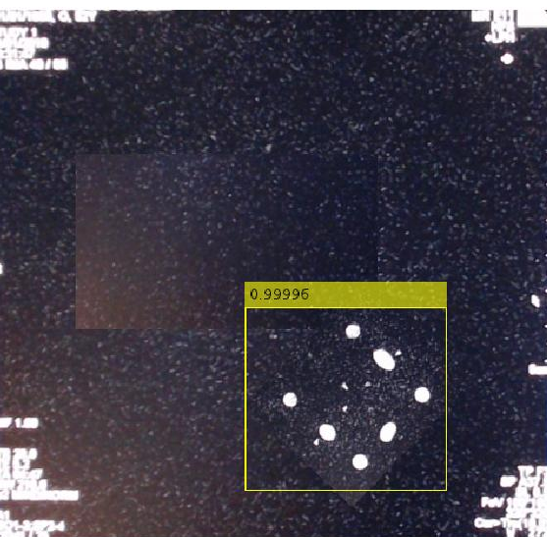
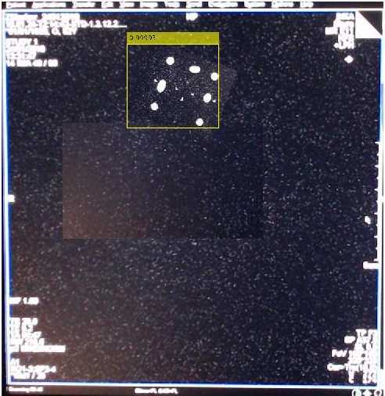
Automatic detection and segmentation of the Z-frame structure
Z-frame detection using faster R-CNN deep learning
Input layer
Middle layers
Convolution2dLayer, reluLayer (rectified linear units), maxPooling2dLayer
Final layers
fullyConnectedLayer, softmaxLayer
Notes:
Start with the imageInputLayer, which defines the type and size of the input layer. For detection tasks, the CNN needs to analyze smaller sections of the image, so the input size must be similar in size to the smallest object in the data set.
This input size is a balance between processing time and the amount of spatial detail the CNN needs to resolve.
Next, define the middle layers of the network. The middle layers are made up of repeated blocks of convolution2dLayer, reluLayer (rectified linear units), and maxPooling2dLayer layers. These layers form the core building blocks of convolutional neural networks.

Slide 9
Image pre-processing
Noise
removal
Contrast
enhancement
Image
binarization
Binary
masking
Notes:
The main drawback of the linear filtering is that the details in the original image will be destroyed during reducing the noise.
Anisotropic diffusion filtering proposed by Perona and Malic [reference] is a technique which reduces the image noise but preserves details and even enhances edges.

Slide 10
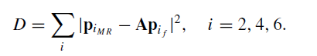
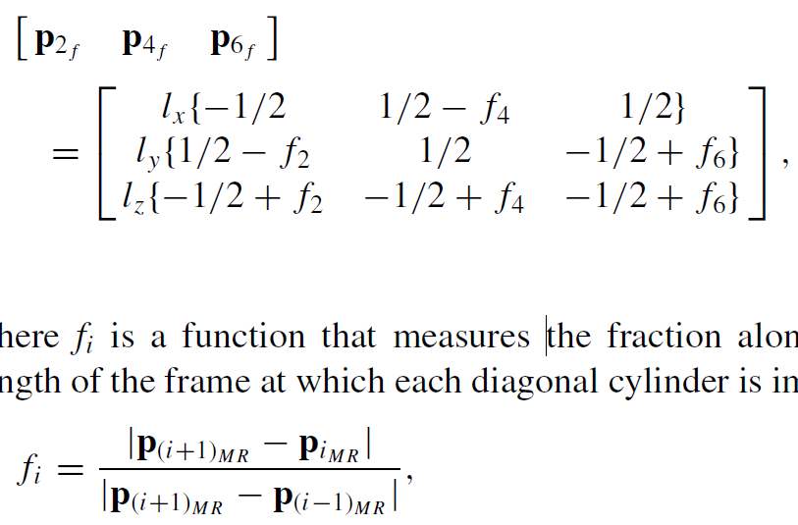
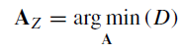
Image pre-processing
2D Gaussian filter:
Localization error = 0.7327
Anisotropic diffusion
Localization error= 0.6114
Median Filter
Localization error= 0.6114
Noise
removal
Localization error:
the Euclidean distance between the predicted marker location, computed from the z-frame registration, and its true position as measured in MR images:
Z-frame registration:
Notes:
The main drawback of the linear filtering is that the details in the original image will be destroyed during reducing the noise.
Anisotropic diffusion filtering proposed by Perona and Malic [reference] is a technique which reduces the image noise but preserves details and even enhances edges.
Localization error: Localization error is defined as the Euclidean distance between the predicted marker location, computed from the z-frame registration, and its true position as measured in the high-resolution MR images.

Slide 11
Image filtering steps
2D Gaussian filter:
Localization error = 0.7327
Anisotropic diffusion
Localization error= 0.6114
Median Filter
Localization error= 0.6114
Noise
removal
Localization error:
the Euclidean distance between the predicted marker location, computed from the z-frame registration, and its true position as measured in MR images:
D=Pf-P
LE=norm(D)
Contrast
enhancement
Image
binarization
Z-frame registration:
Binary
masking
Notes:
The main drawback of the linear filtering is that the details in the original image will be destroyed during reducing the noise.
Anisotropic diffusion filtering proposed by Perona and Malic [reference] is a technique which reduces the image noise but preserves details and even enhances edges.

Slide 12
Image filtering steps
2D Gaussian filter:
Localization error = 0.7327
Anisotropic diffusion
Localization error= 0.6114
Median Filter
Localization error= 0.6114
Noise
removal
Imadjust MATLAB
image= imadjust(image,[0.4 .7],[0 1])
Contrast
enhancement
Image
binarization
Binary
masking
Notes:
The main drawback of the linear filtering is that the details in the original image will be destroyed during reducing the noise.
Anisotropic diffusion filtering proposed by Perona and Malic [reference] is a technique which reduces the image noise but preserves details and even enhances edges.

Slide 13
Image filtering steps
2D Gaussian filter:
Localization error = 0.7327
Anisotropic diffusion
Localization error= 0.6114
Median Filter
Localization error= 0.6114
Imadjust MATLAB
image= imadjust(image,[0.4 .7],[0 1])
Noise
removal
Im2bw MATLAB
Contrast
enhancement
Image
binarization
Binary
masking
Notes:
The main drawback of the linear filtering is that the details in the original image will be destroyed during reducing the noise.
Anisotropic diffusion filtering proposed by Perona and Malic [reference] is a technique which reduces the image noise but preserves details and even enhances edges.

Slide 14
Image filtering steps
2D Gaussian filter:
Localization error = 0.7327
Anisotropic diffusion
Localization error= 0.6114
Median Filter
Localization error= 0.6114
Imadjust MATLAB
image= imadjust(image,[0.4 .7],[0 1])
Noise
removal
Im2bw MATLAB
Contrast
enhancement
Image
binarization
bwareaopen MATLAB
Removal of small objects from the image
Binary
masking
Notes:
The main drawback of the linear filtering is that the details in the original image will be destroyed during reducing the noise.
Anisotropic diffusion filtering proposed by Perona and Malic [reference] is a technique which reduces the image noise but preserves details and even enhances edges.

Slide 15
Image filtering steps
Noise
removal
Imadjust MATLAB
image= imadjust(image,[0.4 .7],[0 1])
Contrast
enhancement
Image
binarization
Im2bw MATLAB
bwareaopen MATLAB
Removal of small objects from the image
Binary
masking
Notes:
The main drawback of the linear filtering is that the details in the original image will be destroyed during reducing the noise.
Anisotropic diffusion filtering proposed by Perona and Malic [reference] is a technique which reduces the image noise but preserves details and even enhances edges.

Slide 16
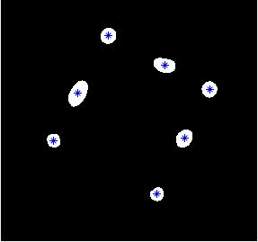
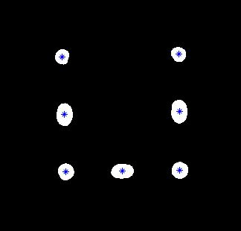
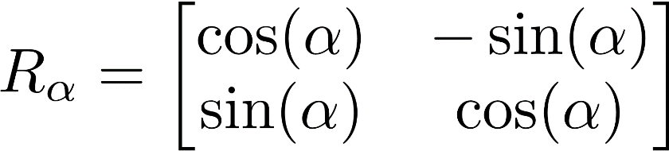
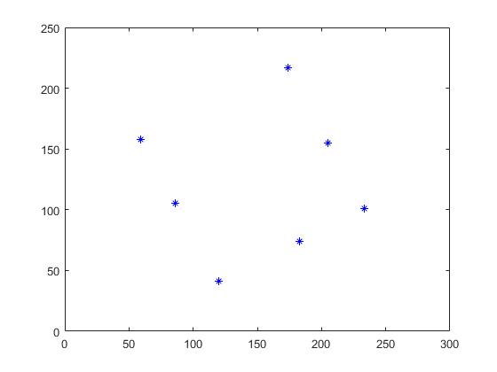
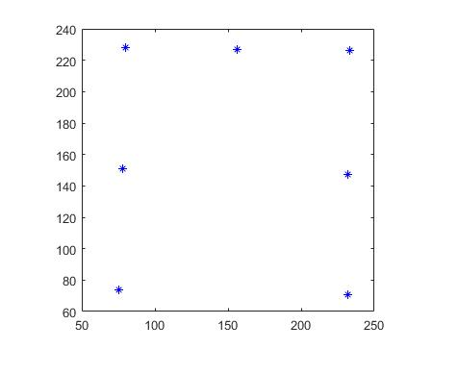
Calibration:
Automatic rotation of the fiducial points
P1
P1
P4
P3
P4
P5
P1
P6
P7
P2
P6
P2
P5
P3
P1
P7

Slide 17
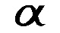
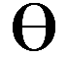
Automatic rotation of the fiducial points
Calculation of the Euclidean distance between each point and its neighbors
Determination of the position of the P1 based on its neighbor's points
Estimation of the rotation angle
Theta= alpha-45+D
Y
*
*
*
Y
*
*
*
*
*
*
*
*
*
P1
*
*
P1
P7
*
*
*
*
P7
*
*
*
*
*
*
*
*
*
*
D=180
x
D=270
x
Y
*
*
*
Y
*
*
*
*
*
*
*
*
*
P1
*
*
P7
P1
*
*
*
*
*
*
P7
*
*
*
*
*
*
*
*
D=90
x
D=0
x

Slide 18
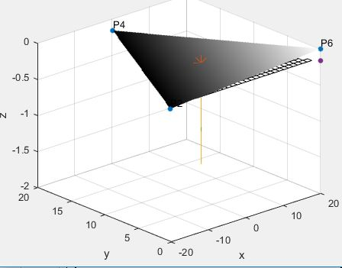
Marker alignment calculation
[p2f p4f p6f]
= -20.0000 -1.1483 20.0000
-0.5648 20.0000 -7.4107
0.5648 1.1483 -7.4107
Rotation around x axis: 10 degree
Rotation around y axis: 10 degree
Notes:
The ordered set of fiducial point coordinates P’ are then applied to compute the 6-DOF pose of the Z-frame with respect to the image plane. Finally, the computed frame position and orientation is used to compute the required motion of the robotic device to reach the target pose.

Slide 19
Conclusion and Outlook
conclusion
Phantom targeting test with Z-RP- frame and an MR-compatible robotic device
Improving the real-time image acquisition setup
Test setup

Slide 20




Thank you for your attention!
Parisa Parsanejad
Parisa.parsanejad@ovgu.de
INKA - Catheter Technologies
Institute for Medical Systems
Faculty of Electrical Engineering and Information Technologies
Otto-von-Guericke-University Magdeburg
Rötgerstr. 9, D-39104 Magdeburg
www.inka-md.de
This work is funded by the BMBF (03IPT7100X)

Slide 21
Backup

Slide 22
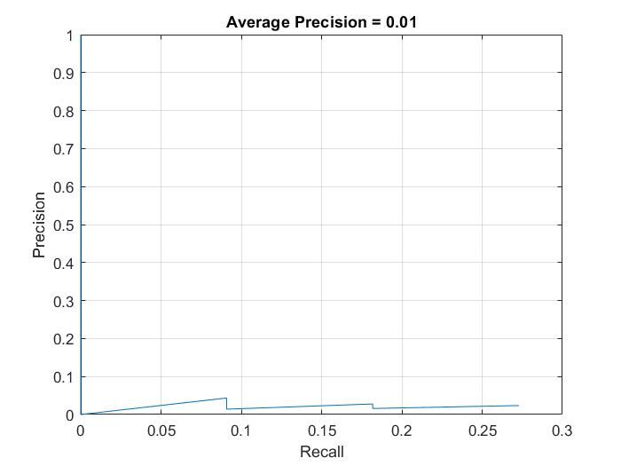
Evaluate detector using test set
Notes:
The precision/recall (PR) curve highlights how precise a detector is at varying levels of recall. Ideally, the precision would be 1 at all recall levels.
The use of additional layers in the network can help improve the average precision, but might require additional training data and longer training time.

Slide 23
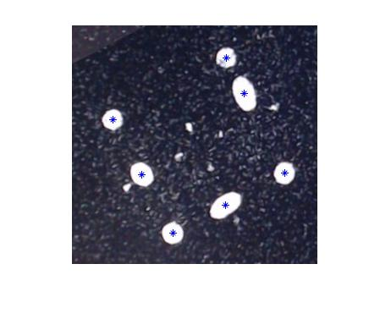
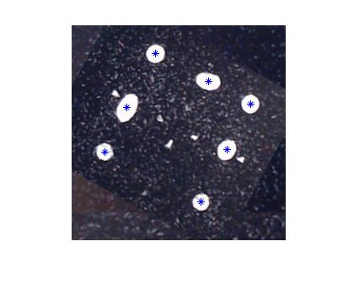
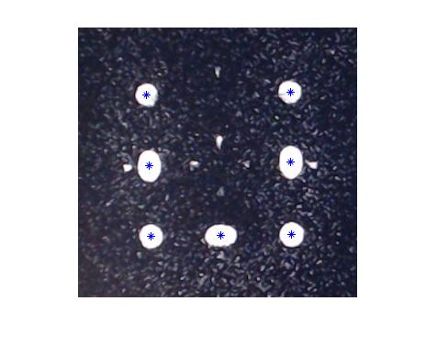
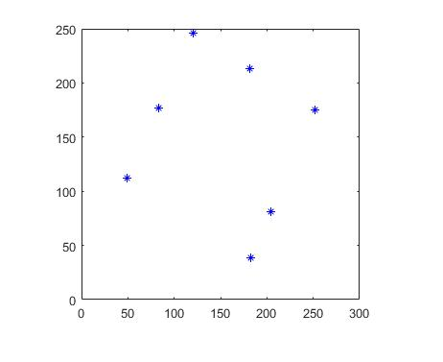
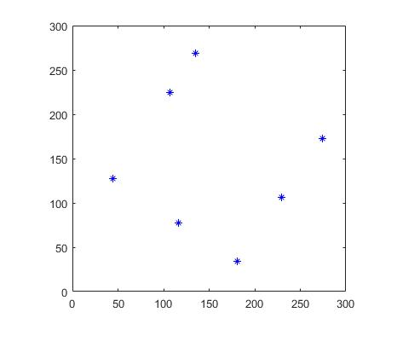
Calibration:
Automatic rotation of the fiducial points
P1
P1
P1
P1
P1
P1

